Slide 1
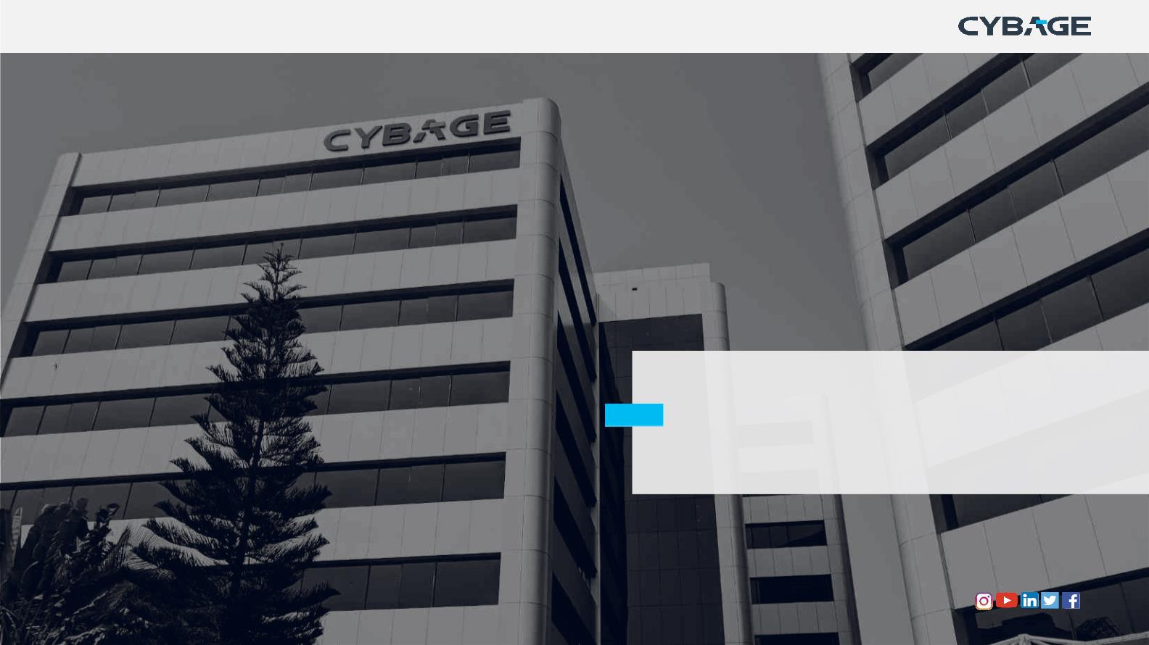
Docker
Copyright © 2018 Cybage Software Pvt. Ltd. All Rights Reserved. Cybage Confidential.
www.cybage.com

Slide 2
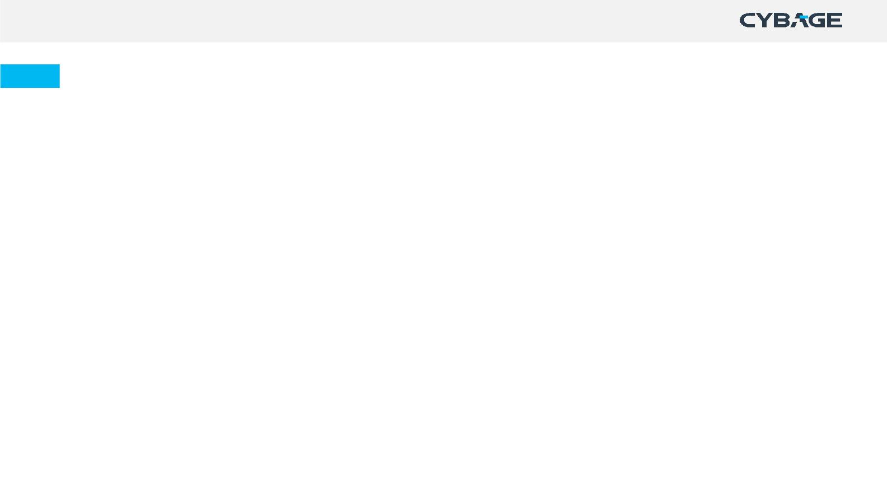
Agenda
• Docker Introduction
• What & Why Docker ?
• Docker vs VM
• Containers
• Docker Engine
• Docker Architecture
• Docker file
• Docker Image
• Best Practices for Dockerfile
• Docker Volume
• Docker Commands
• Demo
Copyright © 2018 Cybage Software Pvt. Ltd. All Rights Reserved. Cybage Confidential.
www.cybage.com

Slide 3
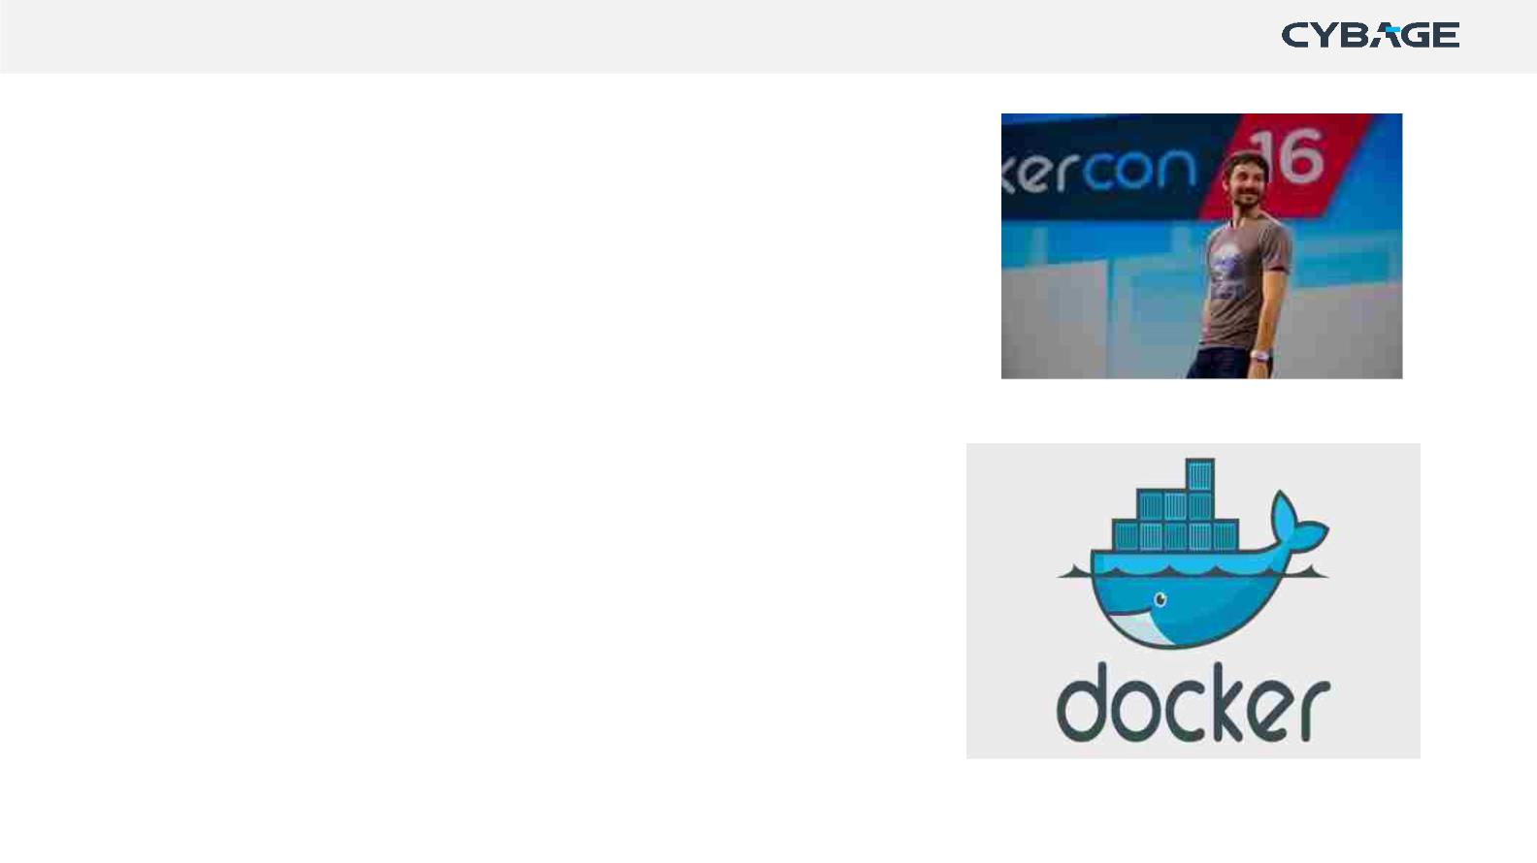
Docker Introduction
Developed by Solomon Hykes and initially released as an open-
source project in March 2013.
Docker gained rapid adoption within the software development
community due to its innovative approach to packaging and
deploying applications.
Written in Go language.
3330+ contributors on GitHub
Reference: https://github.com/docker/docker.github.io
Copyright © 2018 Cybage Software Pvt. Ltd. All Rights Reserved. Cybage Confidential.
www.cybage.com

Slide 4
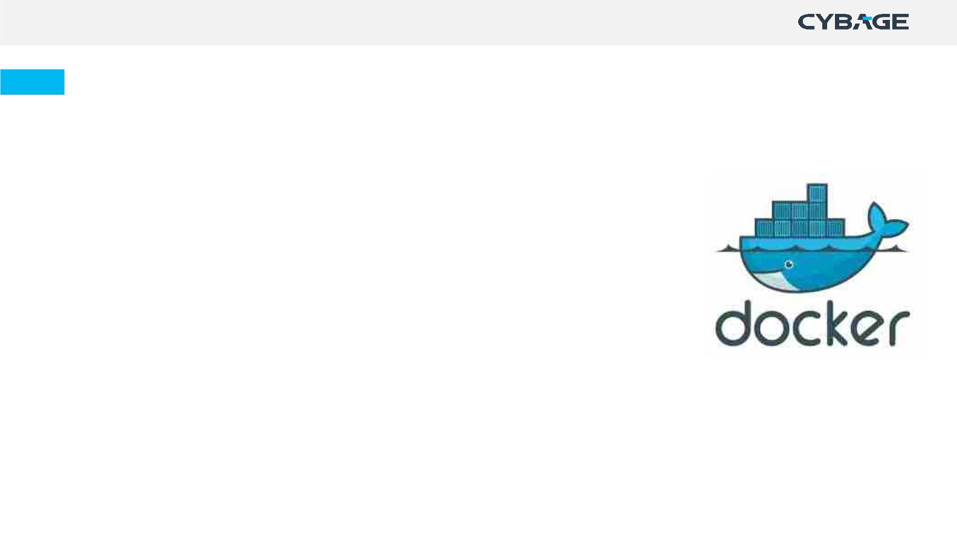
Docker
It is tool used to automate deployment of application in the form of lightweight container so
application can work efficiently on different platform
•
•
•
•
•
•
Docker automates creation of lightweight - Application container
Container will virtually run anywhere
Same container can run on any laptop, desktop, VM, Cloud & more
Unlike VM, it does not include a separate Operating system
Easy to create, deploy & run application using container
Package your application along with all its dependencies together in form of container
Copyright © 2018 Cybage Software Pvt. Ltd. All Rights Reserved. Cybage Confidential.
www.cybage.com

Slide 5

Why Docker?
• Easy to install
• Consistent & Isolated Environment
• Better Portability
• In-Built Version Control System
• Cost-Effective
www.cybage.com

Slide 6
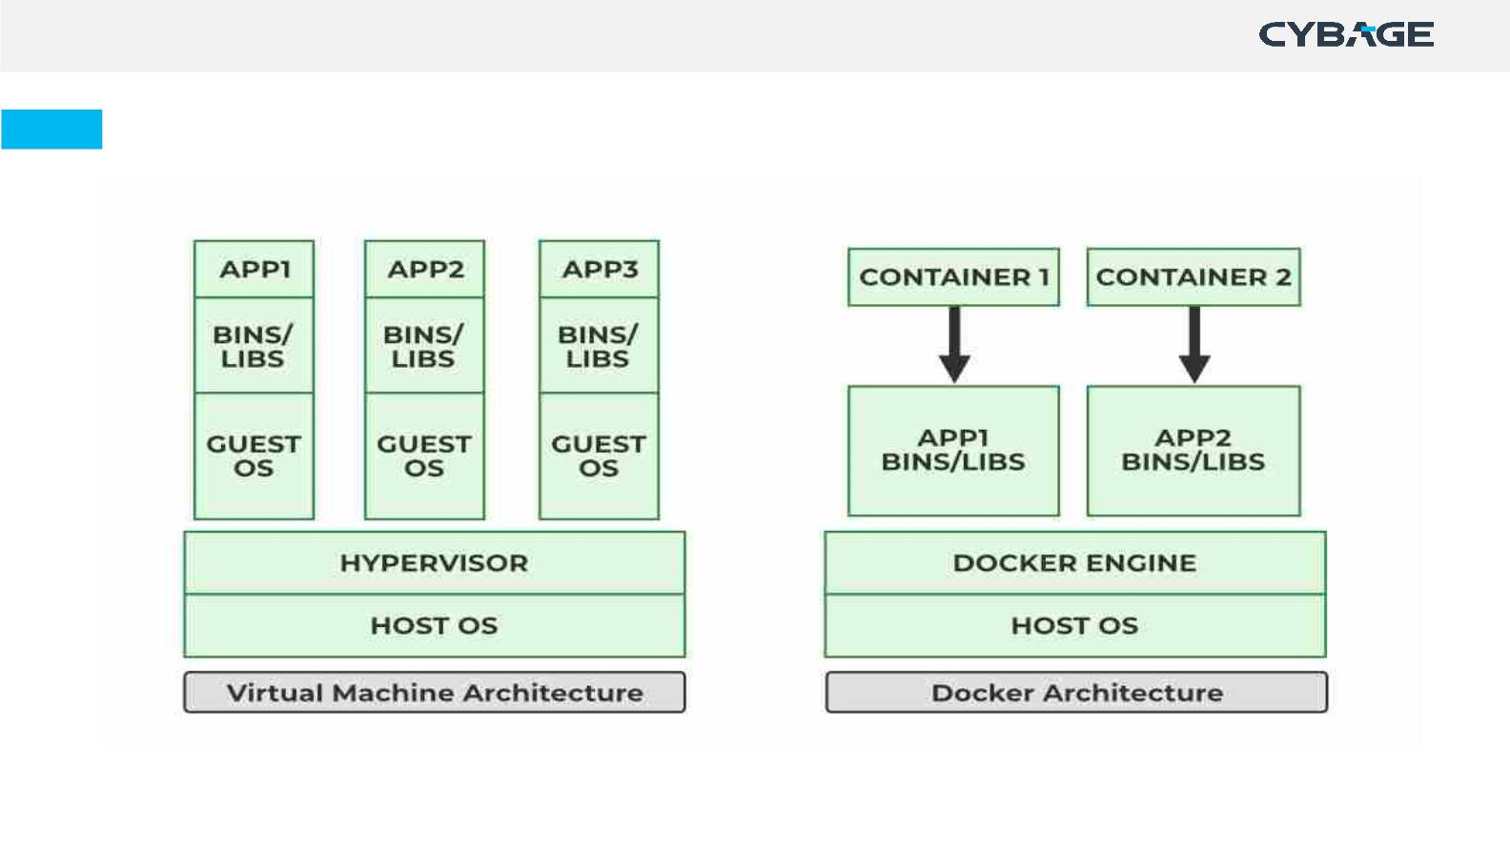
Docker container vs VM
Copyright © 2018 Cybage Software Pvt. Ltd. All Rights Reserved. Cybage Confidential.
www.cybage.com

Slide 7
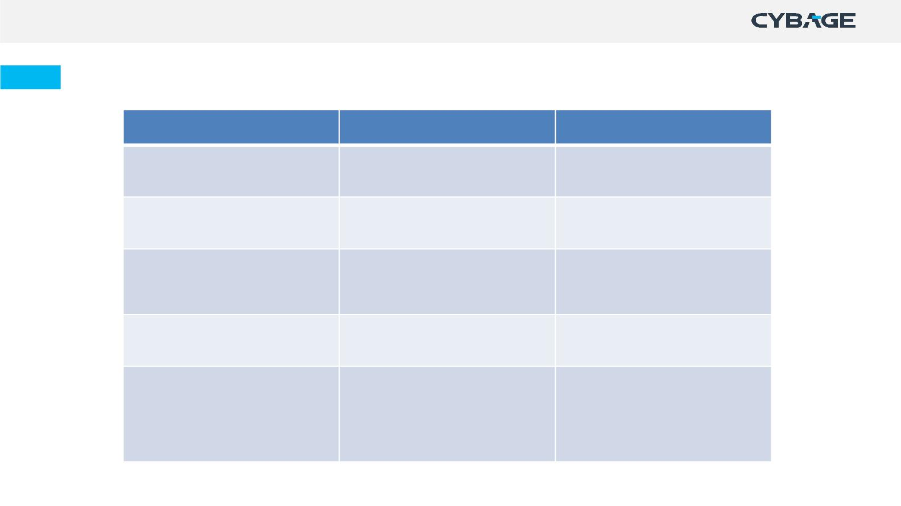
Docker Container vs VM
VMs
Docker Container
Storage
Heavyweight
Lightweight
Operating System
Boot-Time
Each VM has a separate OS
Each container can share OS
It takes a few minutes for VMs Boots in a few seconds
to boot
Memory Management
Deployment
It is less memory efficient.
It is more memory efficient.
Deployment is
Deploying is easy as only a
single image,
containerized can be used
across all platforms.
comparatively lengthy as
separate instances are
responsible for execution
Copyright © 2018 Cybage Software Pvt. Ltd. All Rights Reserved. Cybage Confidential.
www.cybage.com

Slide 8
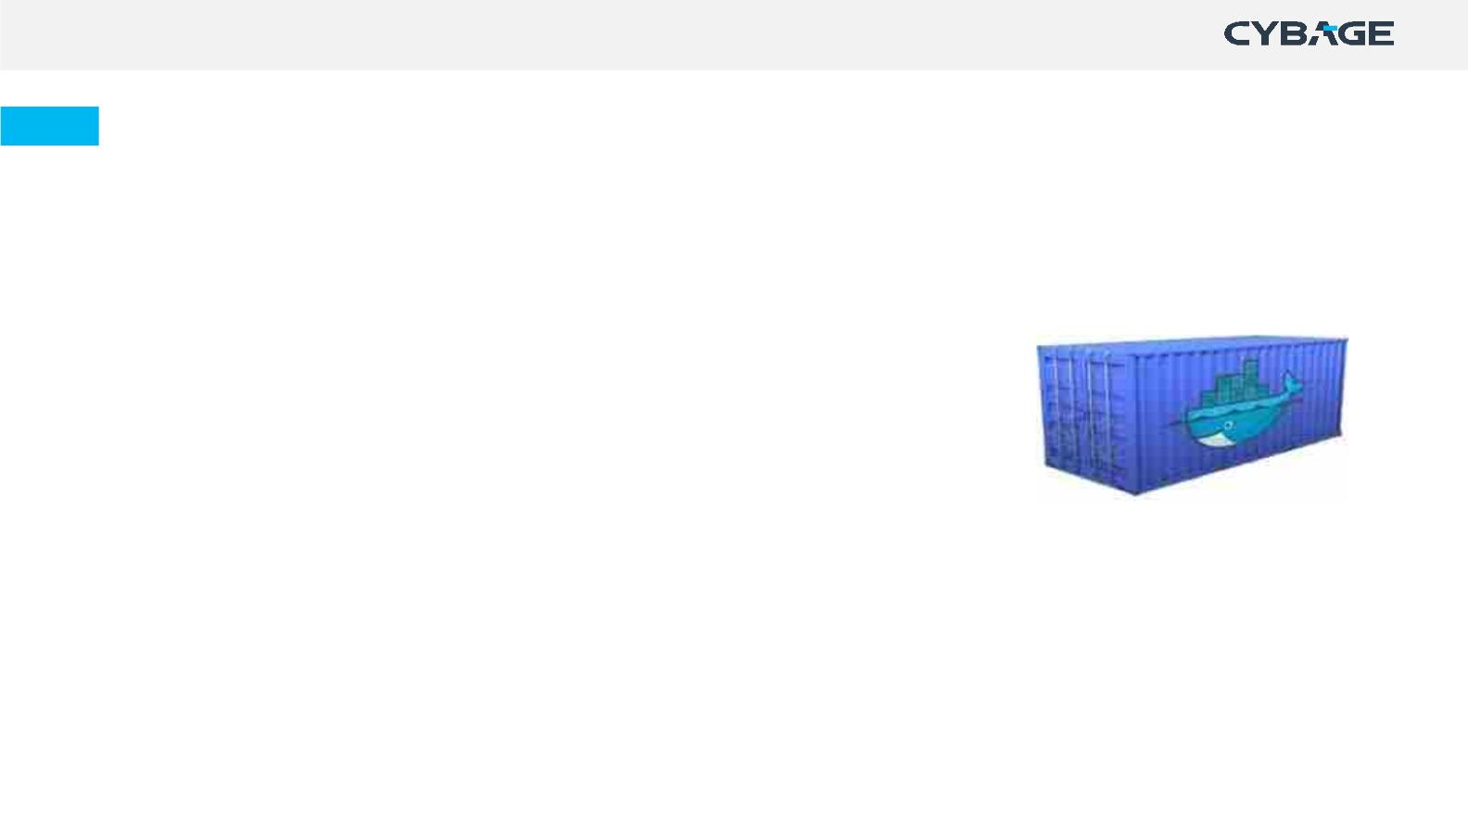
Containers
• A portable executable package which includes applications and their
dependencies.
• Runnable instance of an image
• Lighter than VM.
Why Containers ?
• Boots in seconds
• 100-1000 containers on one Machine/VM
• Same Container can be deployed to any Dev, Test & Prod servers
Copyright © 2018 Cybage Software Pvt. Ltd. All Rights Reserved. Cybage Confidential.
www.cybage.com

Slide 9
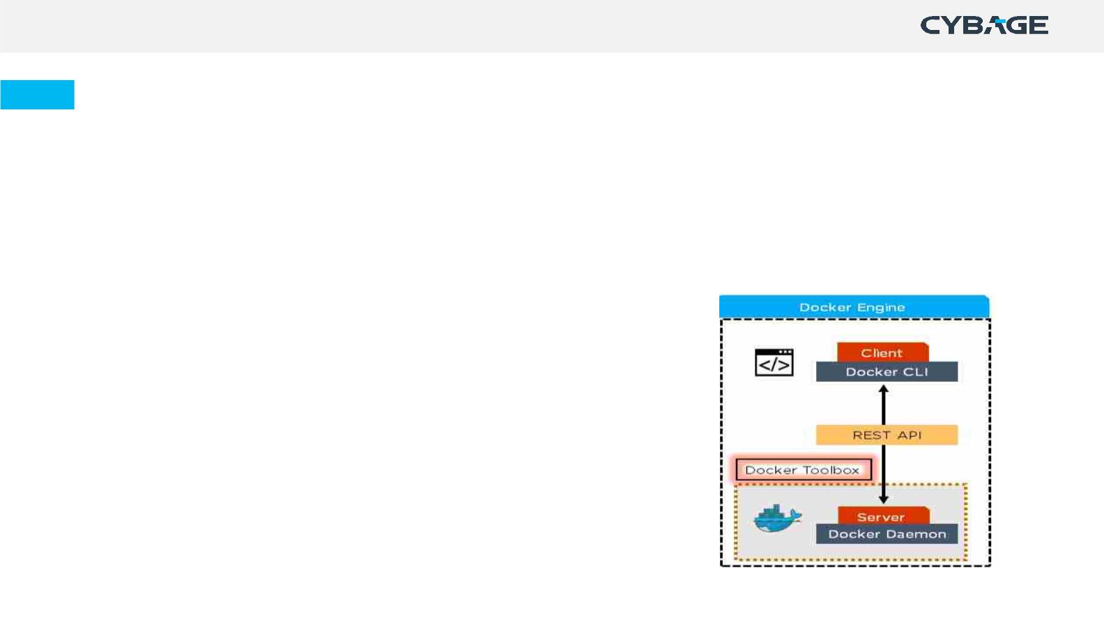
Docker Engine
Docker Daemon(Server) :
Docker is a client-server application that builds and executes containers using Docker
components.
Checks the client request and communicates with the Docker components in order to perform
a service
• Builds images
• Runs and manages Containers
• RESTful API
Docker CLI(Client):
A service which uses REST API to send requests to
Docker Daemon through CLI commands.
Copyright © 2018 Cybage Software Pvt. Ltd. All Rights Reserved. Cybage Confidential.
www.cybage.com

Slide 10
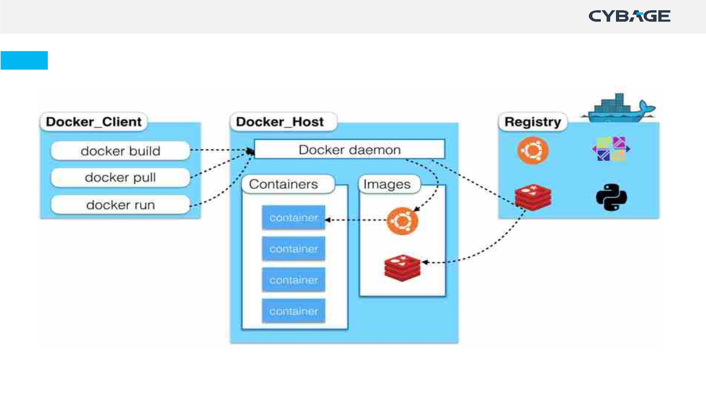
Docker Architecture
Copyright © 2018 Cybage Software Pvt. Ltd. All Rights Reserved. Cybage Confidential.
www.cybage.com

Slide 11
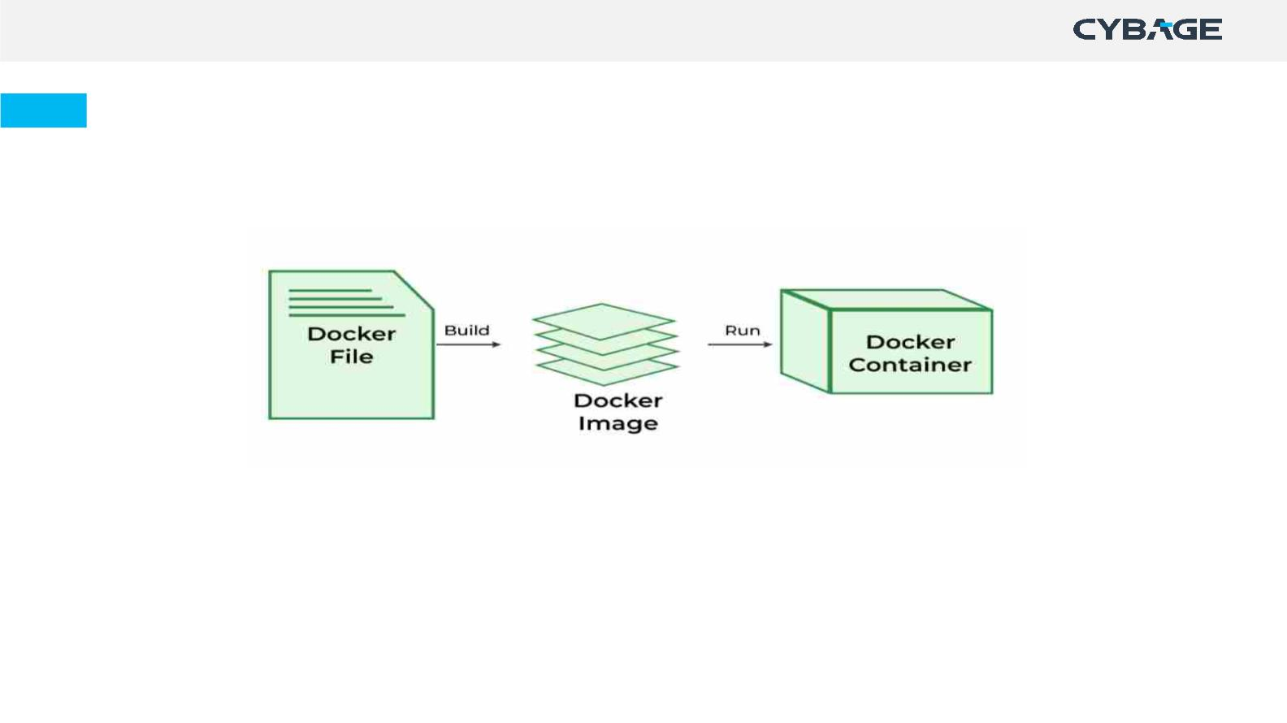
Dockerfile
Dockerfile is a text file that contains a set of instructions that are used to
create a Docker image.
• Using Dockerfile we build a Docker Image with the help of docker build
command.
• Dockerfile is use to create automated build that executes several
command-line instructions in succession.
Copyright © 2018 Cybage Software Pvt. Ltd. All Rights Reserved. Cybage Confidential.
www.cybage.com

Slide 12
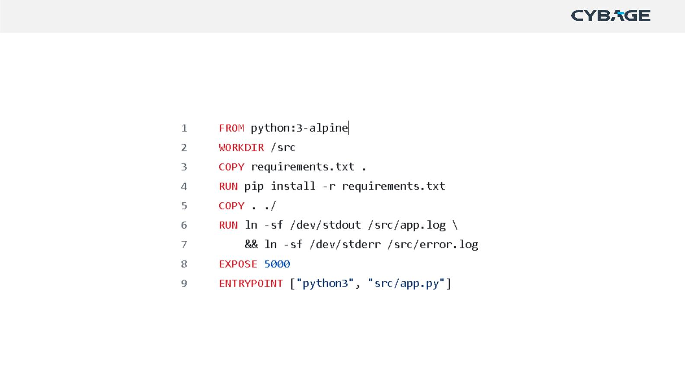
Dockerfile
Example:
Copyright © 2018 Cybage Software Pvt. Ltd. All Rights Reserved. Cybage Confidential.
www.cybage.com

Slide 13
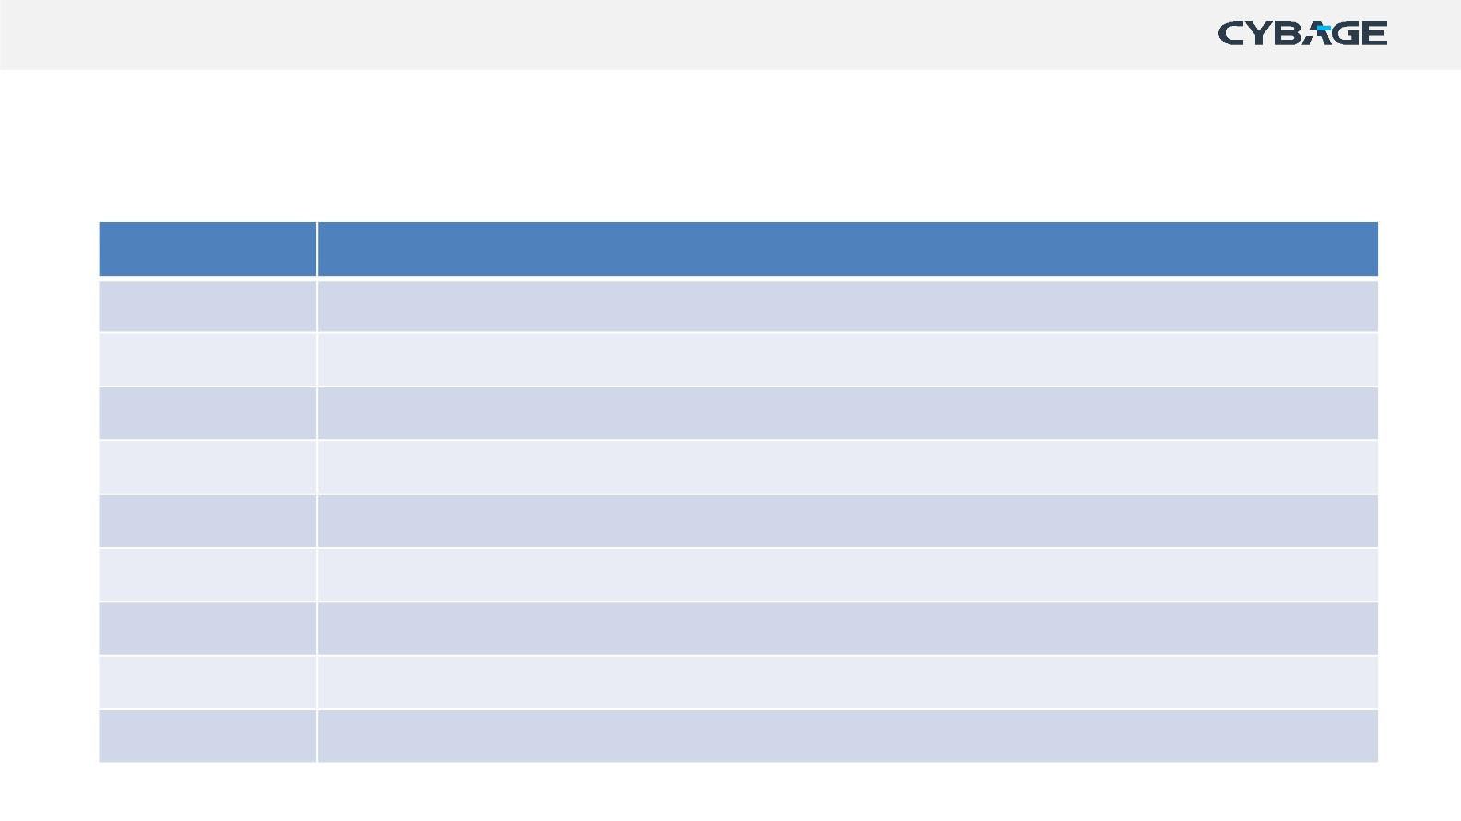
Dockerfile Instruction
Basic instruction used in Dockerfile
Instruction Description
FROM
WORKDIR
ADD
Specify base image
Set working directory
Copy files, directories or remote url files to container image
Copy files, directories to container image
Execute specific command
COPY
RUN
CMD
Specify command at the time of containerexecution
ENTRYPOINT Configure and run container as an executable
ARG
Defines variable that user can pass at a build time
Specify metadata information in key-value pair
LABEL
Copyright © 2018 Cybage Software Pvt. Ltd. All Rights Reserved. Cybage Confidential.
www.cybage.com

Slide 14
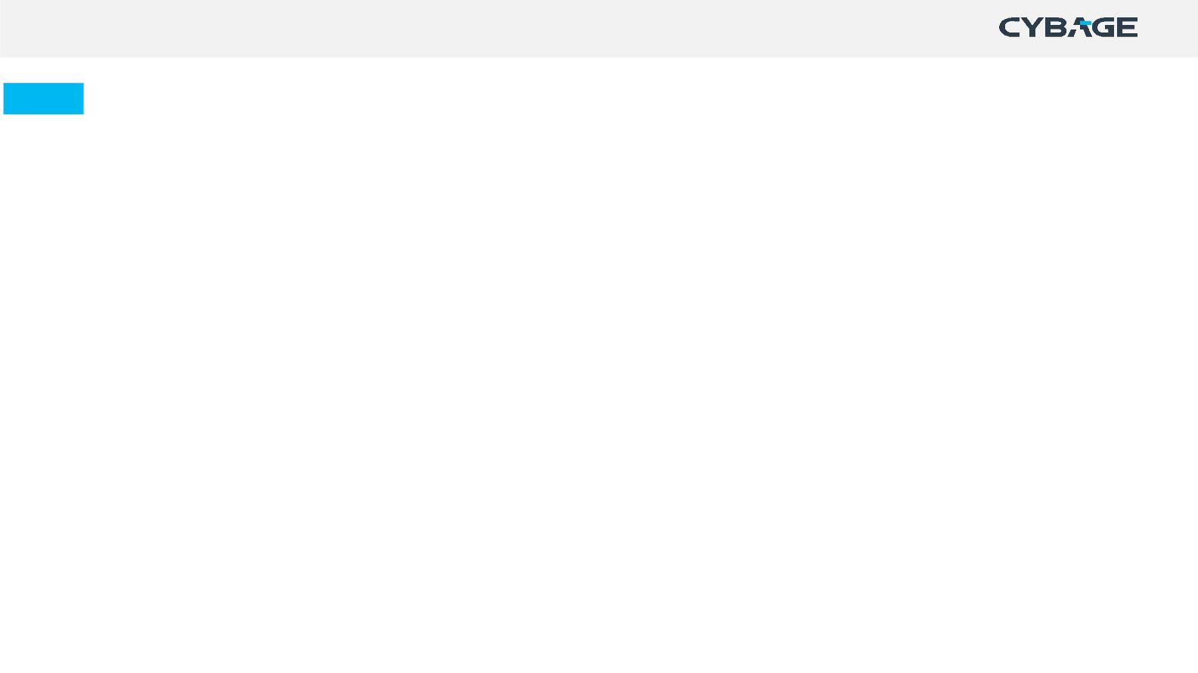
CMD & ENTRYPOINT
CMD: Sets default parameters that can be overridden from the Docker command line
interface (CLI) while running a docker container.
ENTRYPOINT: Sets default parameters that cannot be overridden while executing Docker
containers with CLI parameters.
COPY & ADD
COPY : Use to copy local files to a given path.
ADD : Use to copy local files as well as files from remote location.
also extract .tar files to a specified path.
Copyright © 2018 Cybage Software Pvt. Ltd. All Rights Reserved. Cybage Confidential.
www.cybage.com

Slide 15

Best Practices for Dockerfile
• Use an official and verified Docker image as a base image, whenever
available.
• Use specific Docker image versions
• Optimize caching for image layers when building an image.
• Use .dockerignore file
• Use the Least Privileged User
• Scan your Images for Security Vulnerabilities
Copyright © 2018 Cybage Software Pvt. Ltd. All Rights Reserved. Cybage Confidential.
ws ww.cybage.com

Slide 16
Docker Image
• Used to execute code in a Docker container.
• Built from the instructions from Dockerfile.
• Docker image contains application code, libraries, tools, dependencies and
other files needed to make an application run.
• Docker users store images in private or public repositories – Docker Hub
Copyright © 2018 Cybage Software Pvt. Ltd. All Rights Reserved. Cybage Confidential.
www.cybage.com

Slide 17
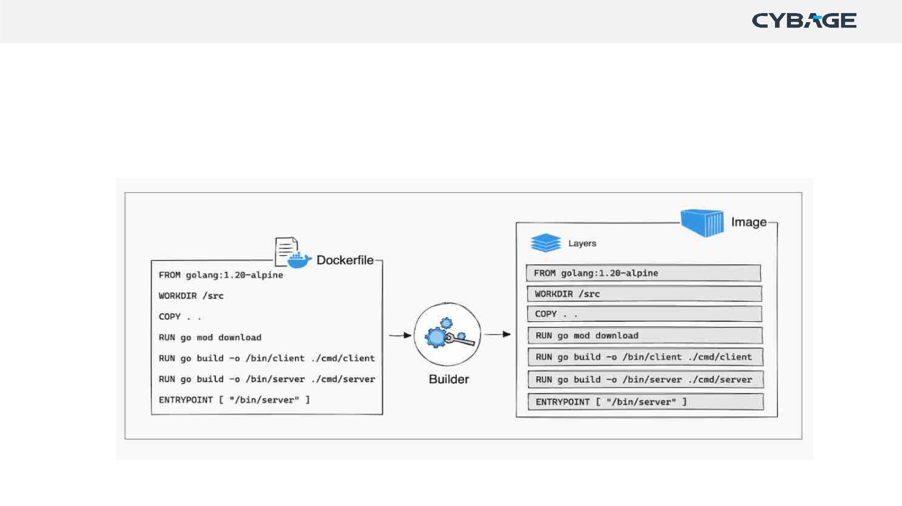
Docker Layering
• Docker images are built on a layered file system called Union File System
(UnionFS).
• Each instruction in a Dockerfile represents a layer in the image.
Copyright © 2018 Cybage Software Pvt. Ltd. All Rights Reserved. Cybage Confidential.
www.cybage.com

Slide 18

Docker Volume
Volumes:
Docker volumes are a filesystem used in docker to persist data of a
container independent of its life cycle.
Types:
• Named Volumes
• Unnamed Volumes (Anonymous volumes)our host machine on linux at
this
• Bind Mounts
Copyright © 2018 Cybage Software Pvt. Ltd. All Rights Reserved. Cybage Confidential.
www.cybage.com

Slide 19
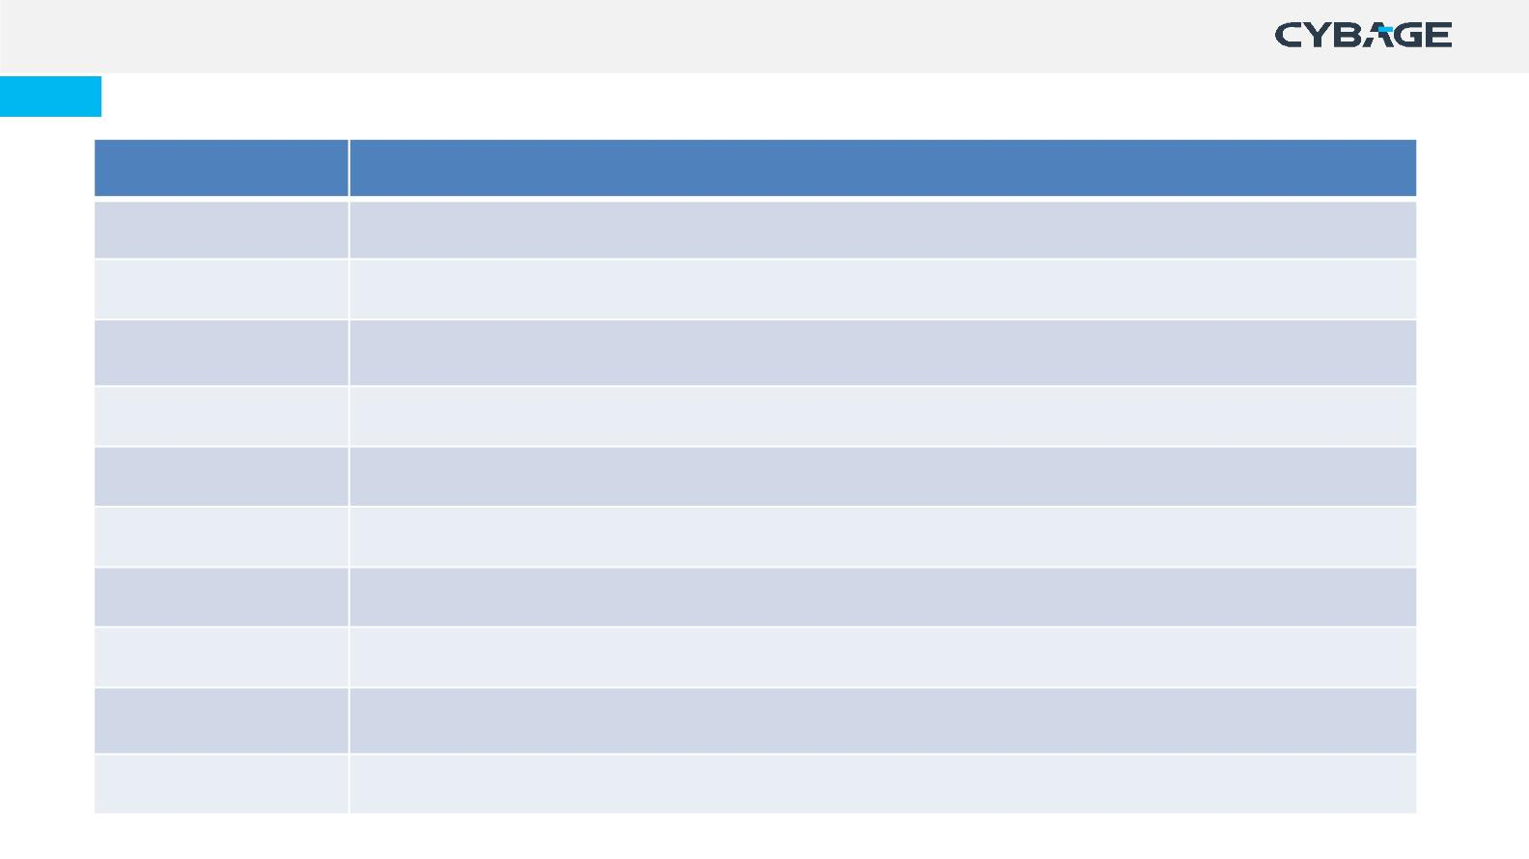
Docker Commands
Command
Build
Description
Builds Docker images from a Dockerfile
Commit
cp
Create a new image from a container's changes
Copy files/folders from a container's filesystem to the host path
create
exec
Create a new container
Run a command in a running container
Show the history of an image
List images
history
images
info
Display system-wide information
Return low-level information on a container or image
inspect
kill
Kill a running container
Copyright © 2018 Cybage Software Pvt. Ltd. All Rights Reserved. Cybage Confidential.
www.cybage.com

Slide 20
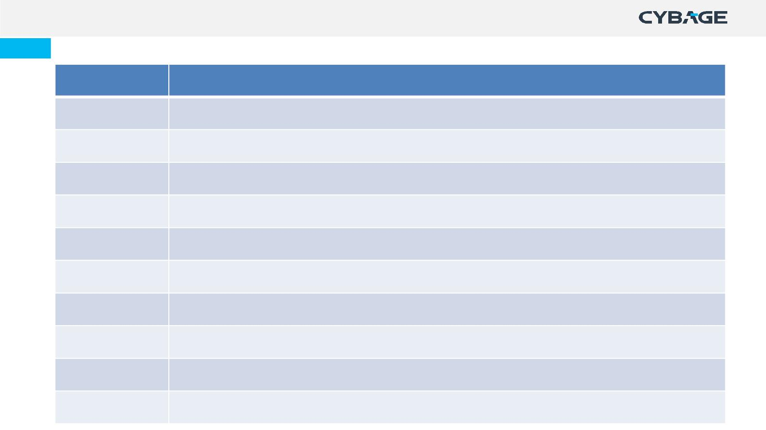
Docker Commands
Command
load
Description
Load an image from a tar archive
login
Register or log in to a Docker registry server
Log out from a Docker registry server
Fetch the logs of a container
logout
logs
pause
unpause
port
Pause all processes within a container
Unpause a paused container
Lookup the public-facing port that is NAT-ed to PRIVATE_PORT
List containers
list
Pull
Pull an image or a repository from a Docker registry server
Push an image or a repository to a Docker registry server
push
C

Slide 21
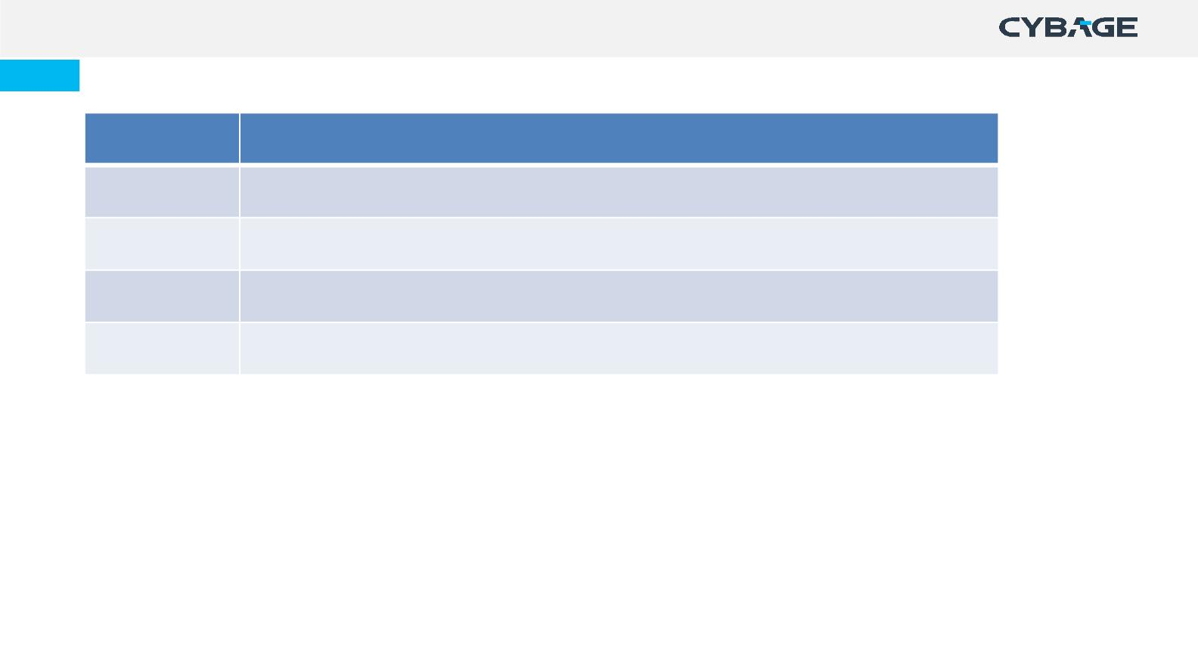
Docker Commands
Command Description
tag
Tag an image into a repository
top
Lookup the running processes of a container
Show the Docker version information
version
wait
Block until a container stops, then print its exit code
Copyright © 2018 Cybage Software Pvt. Ltd. All Rights Reserved. Cybage Confidential.
www.cybage.com

Slide 22
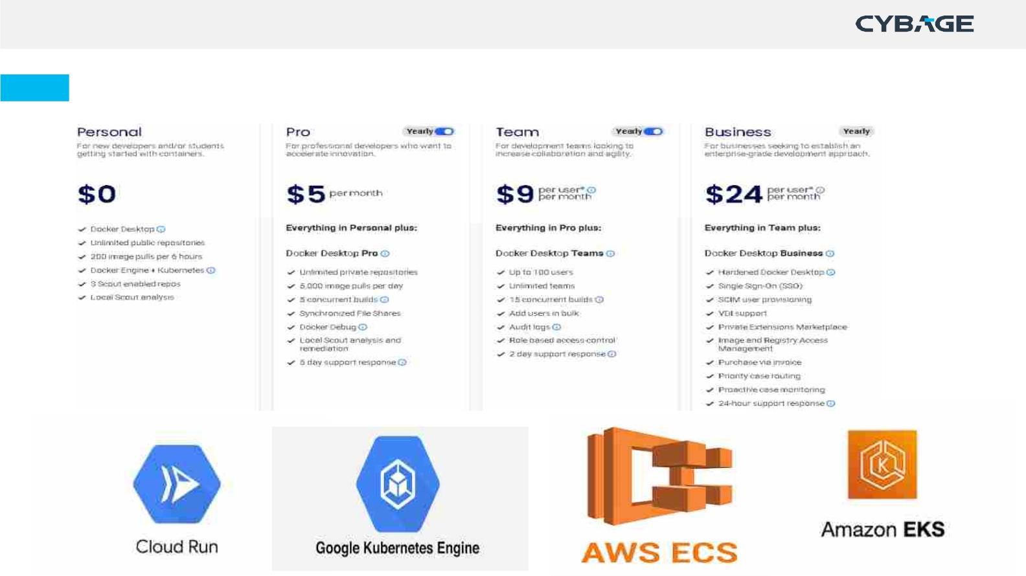
Docker licensing & cloud offerings

Slide 23
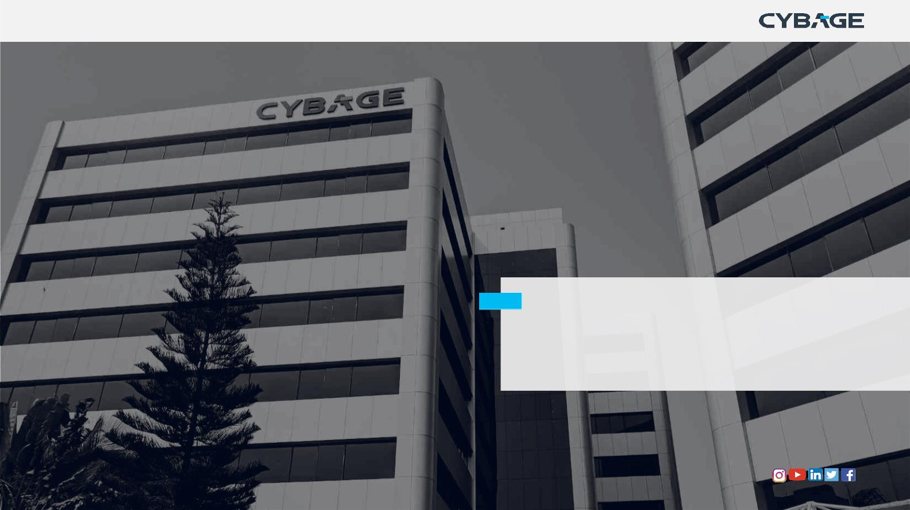
Thank You!
Copyright © 2018 Cybage Software Pvt. Ltd. All Rights Reserved. Cybage Confidential.
www.cybage.com

